Slide 1
Identifying Transmembrane Helices in Tertiary Structures
SSBI – Project 3
Marco Klein, Julian Späth, Julius Vetter

Slide 2
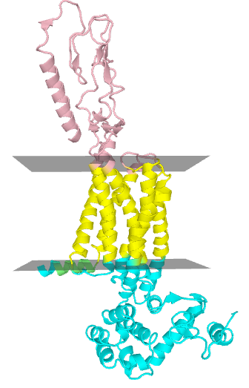
Transmembrane (TM) Proteins
Perform many important physiological tasks
Molecule transport
Cell signaling
Contained substructures
Helix bundle
Beta barrel

Slide 3
Motivation & Goal
Only few determined tertiary structures
PDB entries have no information on membrane topology
Calculate membrane geometry
PDB
entry
Is helix TM?
Helices
TM
Helices
Classifier
Notes:
where the membrane is relative to the protein structure

Slide 4
Data Processing
PDBTM Database
Annotates transmembrane regions in proteins
Find overlap between
Annotated TM regions (PDBTM)
Helix regions (PDB)
Overlap ≥ 70% → positive samples = 0% → negative samples
Additional negative samples from globular proteins
35,000 TM vs 48,000 Non-TM helices
Notes:
we do not use such helices for the training of our model
Dataset size TODO!!!

Slide 5
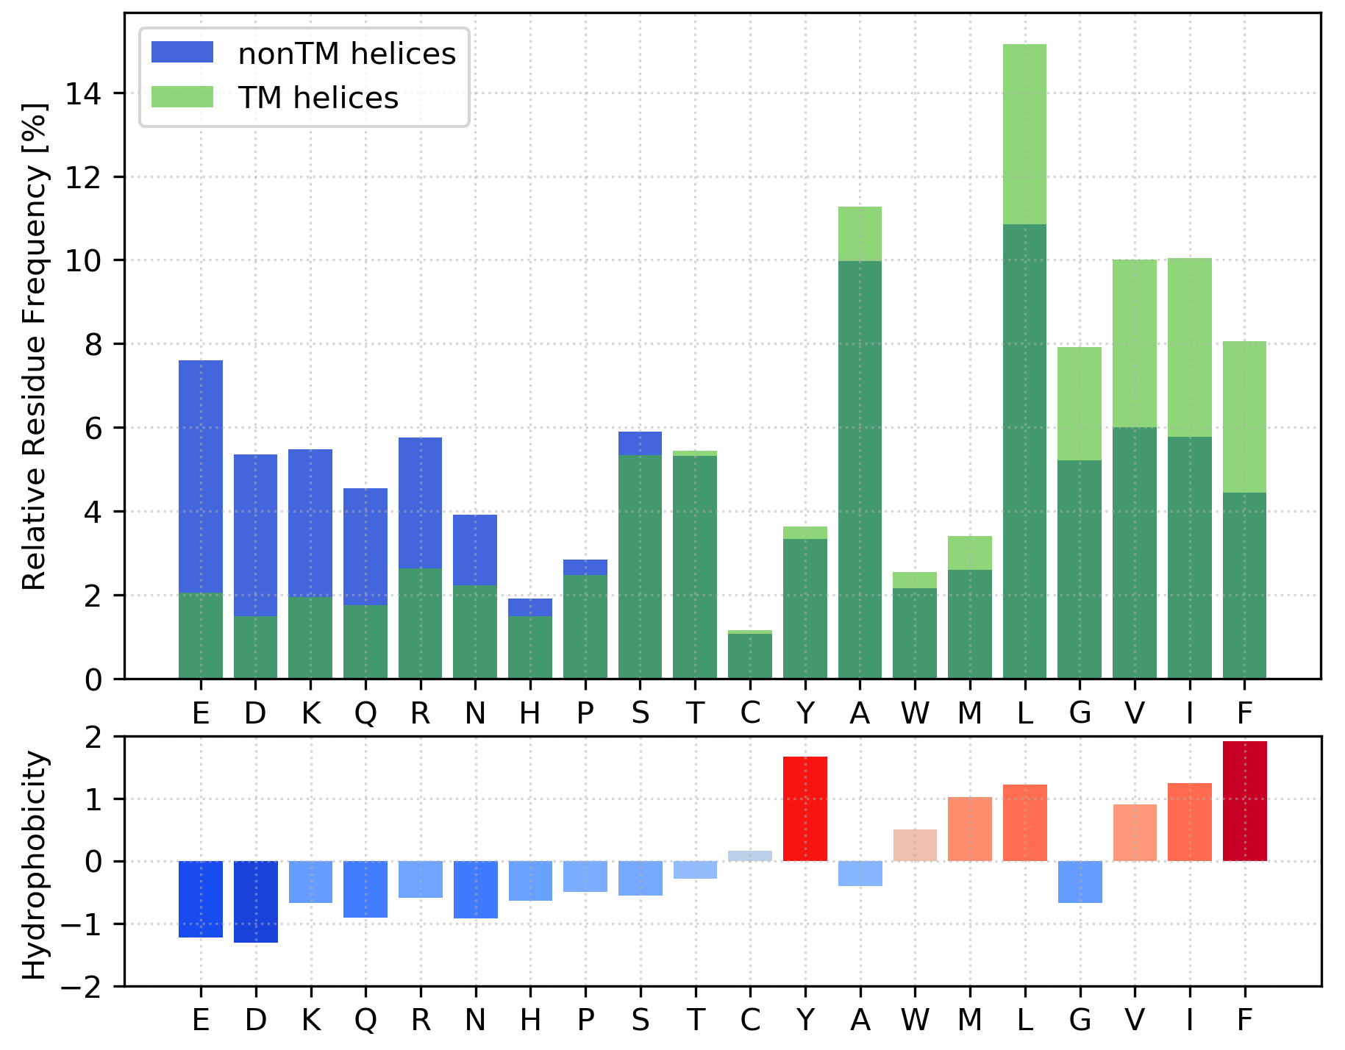
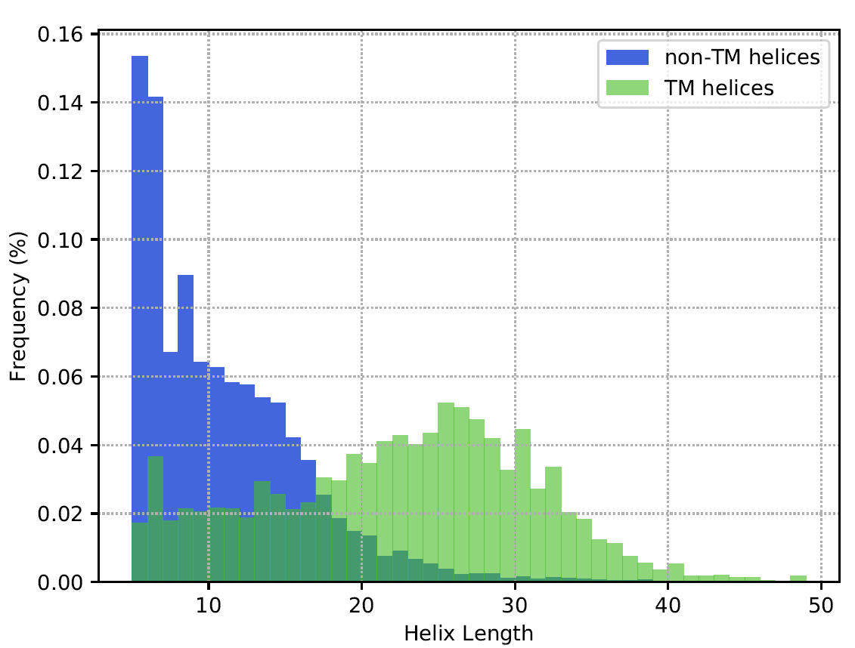
TM vs non-TM helices
Amino acid composition
Helix length
Notes:
The data has shown some interesting insights into the properties of transmembrane and non-transmembrane helices
The left plot shows the Amino acid composition of transmembrane helices in green and non transmembrane helices in blue. The darker green shows the overlap.
As can be seen the amino acids overrepresanted in transmembrane helices tend to be hydrophobic → Here more on the right, and hydrophobicity in red
On the other side the amino acids underrepresnented in transmembrane helices tend to be hydrophilic, here shown in blue.
Furthermore there are differences in the helix lengths: as shown on the right plot the non transmembrane helices in blue are usually shorter than the transmembrane helices
1:30 would be nice

Slide 6
Helix Classification
Features: amino acid counts
Example: PYYTIKDILGALLLILALMLLVL
Classifier: Support Vector Machine (SVM)
linear and rbf kernels
30 % Test data for evaluation
70 % Training data
5-fold grid search cross validation for SVM parameters (C, γ)
A | C | D | E | F | G | H | I | K | L | M | N | P | Q | R | S | T | V | W | Y
2 | 0 | 1 | 0 | 0 | 1 | 0 | 3 | 1 | 9 | 1 | 0 | 1 | 0 | 0 | 0 | 1 | 1 | 0 | 2
Notes:
Due to that insights we chose the features of our classifier: the amino acid counts which include both the length as well as the frequency information
For Example the sequence here results in the following vector of length 20 contianing the count of each amino acid
For an independent evaluation we split our dataset into a test and training set
The 30% test data was only used for evaluation to check how a model performs on unseen data
The 70% training data was used for the training of an SVM and the grid search parameter optimization which was done by a 5 fold cross validation
We tested a wide range of C and gamma values for the linear and rbf kernels

Slide 7
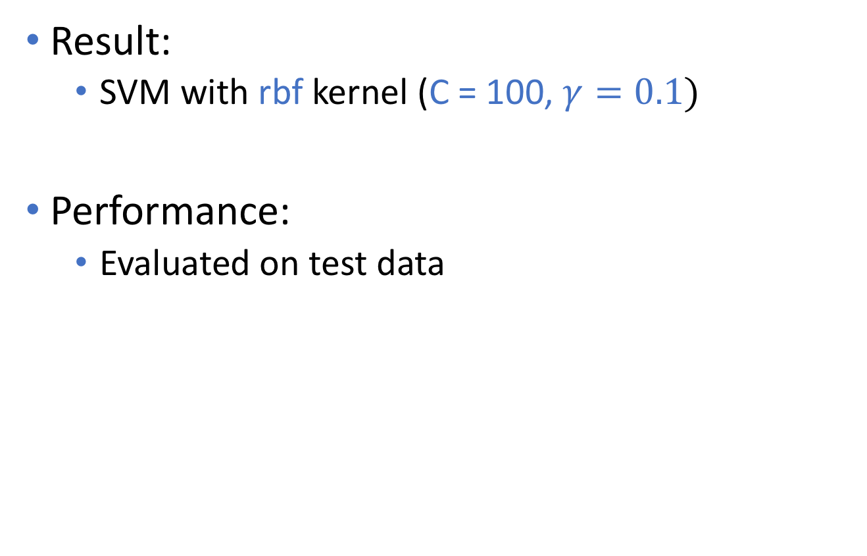
Helix Classification
Result:
SVM with rbf kernel (C = 100, $γ=0.1)$
Performance:
Evaluated on test data
Sensitivity | Specificity | MCC
0.96 | 0.96 | 0.92
Notes:
This cross validation on the training set resulted in a SVM using rbf kernel with C=100 and gamma 0.1
The SVM achieved a sensitivity and specificity of 0.96 and a Matthews correlation coefficient of 0.92 which is a very high.

Slide 8
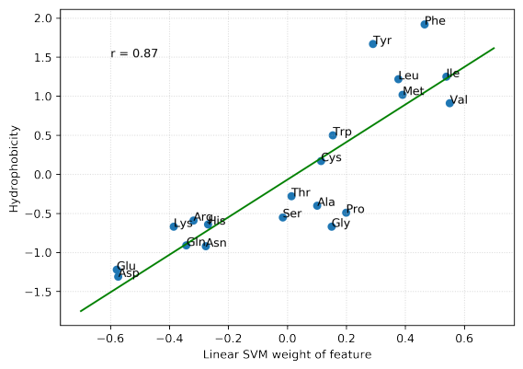
Linear SVM Weights
SVM learned hydrophobicity measure without prior knowledge
Notes:
- Out of curiosity we also looked at the weights of the linear svm due to the fact that they are easily interpretable and we found that the weights of the different amino acids correspond linearly to their hydrophobicity of the amino acids.
- Hence, the linear SVM has learned to primarily consider the hydrophobicity of the helix for classification, despite never having had access to explicit hydrophobicity figures.

Slide 9
Membrane Geometry Calculation
Preliminary geometry
Filter potential FP transmembrane helices via angle and distance information
Remaining helices
→ first PCA loading vector = Membrane normal
Optimisation
Objective function: Q-value (Tusnády, 2004)
Sample test vectors in cone around normal vector
Take vector with highest Q-value

Slide 10
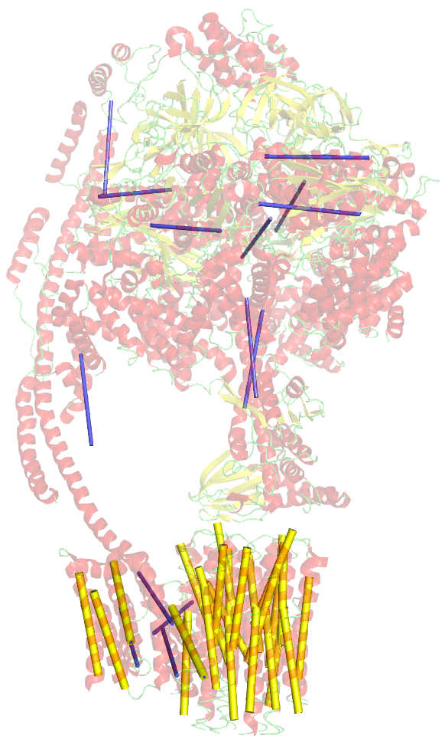
False Positive Removal
Filter helices that are inconsistent with the majority using pairwise distances and angles
Angle and distance criteria filter False Positive helices quite reliably
5ARH
Blue: classified as TM, filtered out
Yellow: used for membrane calculation
Notes:
Using pairwise angles and distances between helices, We filtered those helices that were inconsistent with the majority of the helices. This inconsistency is defined by an angle and distance cutoff

Slide 11
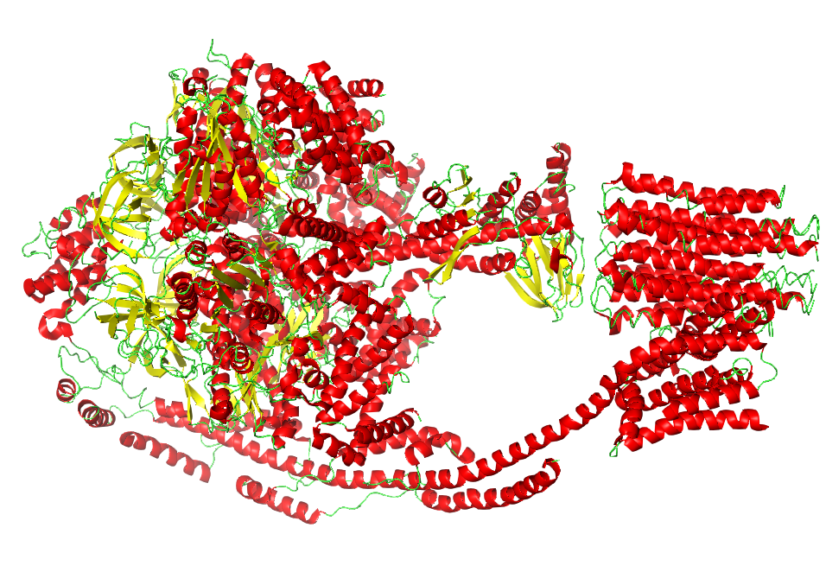
Protein 5ARH
(ATP synthase)

Slide 12
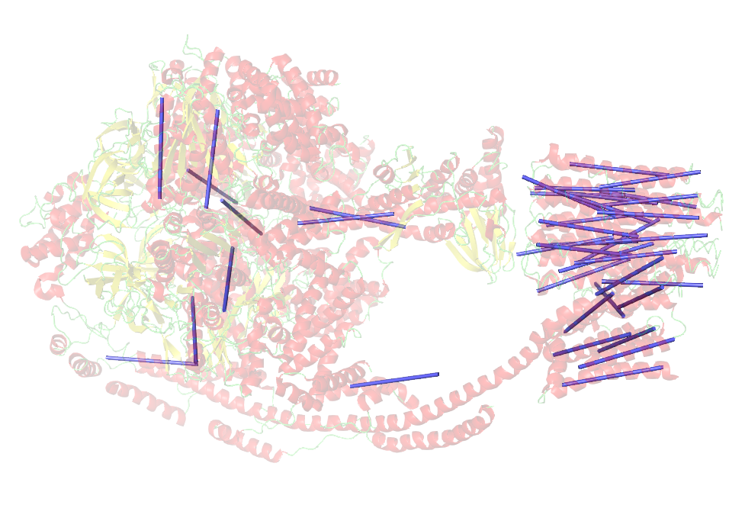
Helices classified
as transmembrane

Slide 13
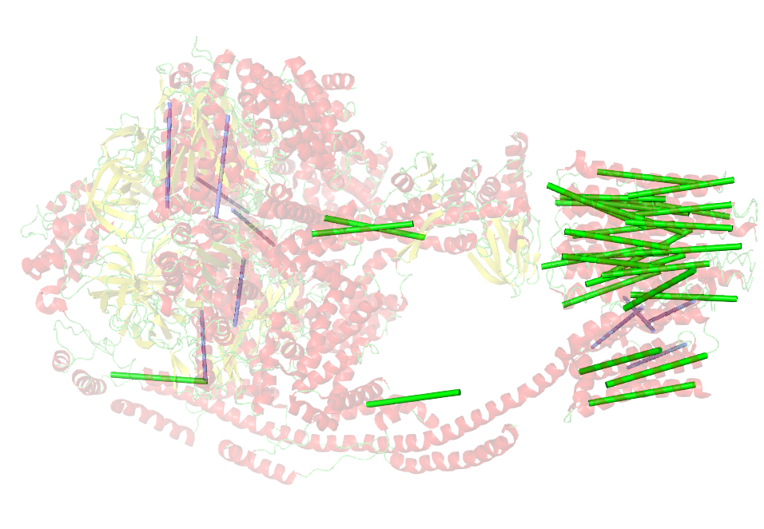
Filter 1:
by angle

Slide 14
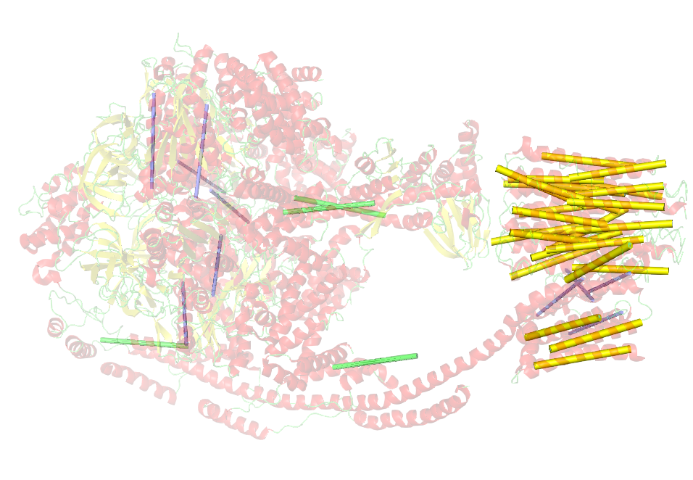
Filter 2:
by distance

Slide 15
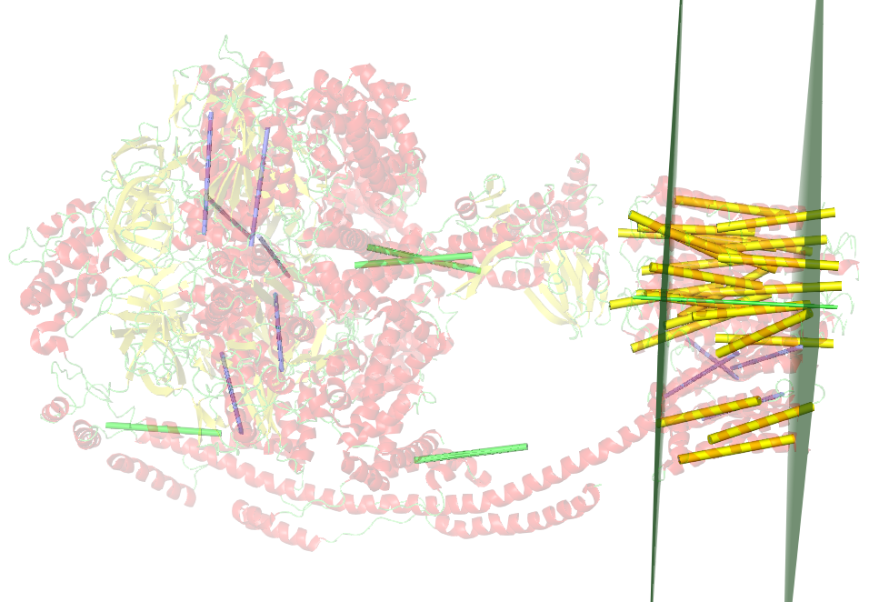
Membrane
calculation

Slide 16
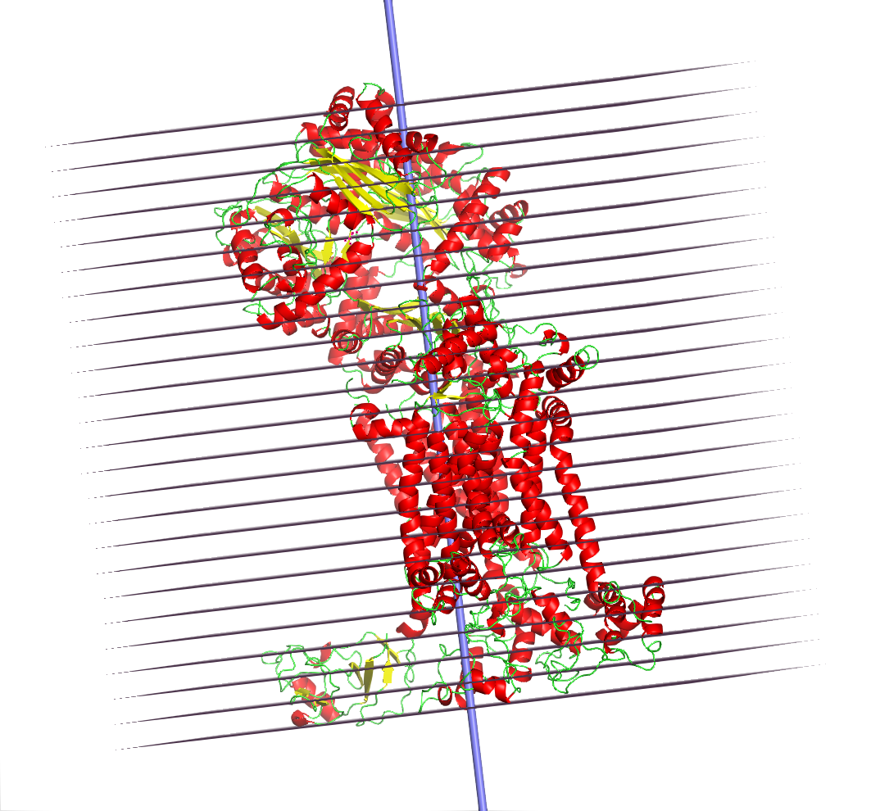
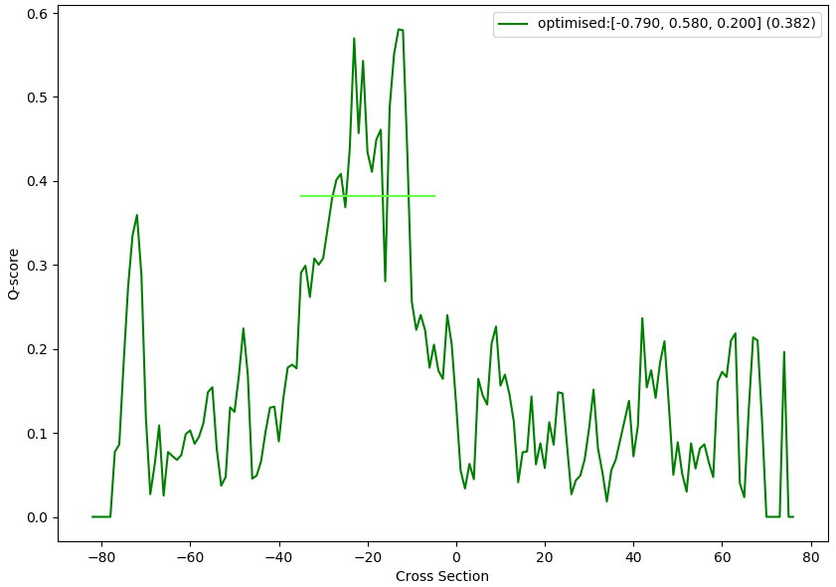
Membrane Geometry Calculation
Divide tertiary structure into slices
Calculate hydrophobic and geometric factors

Slide 17
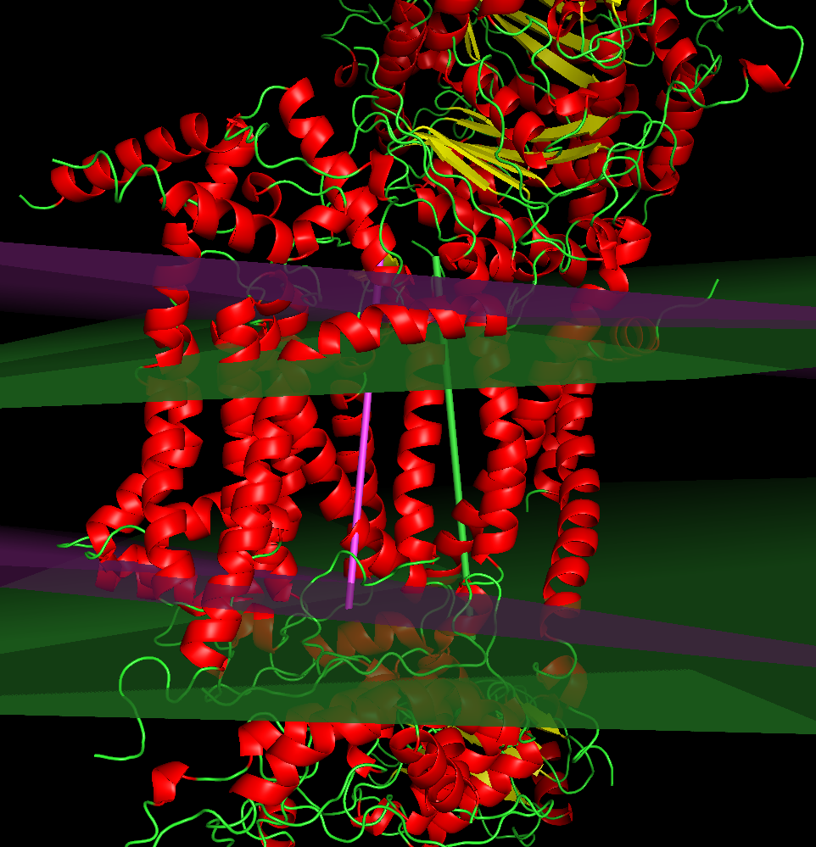
Optimisation Result
1BE3, purple: before, green: after

Slide 18
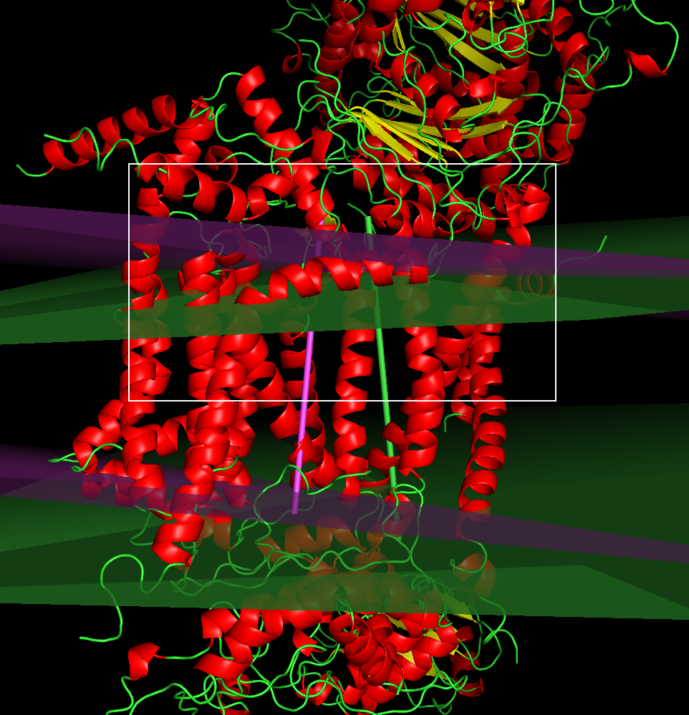
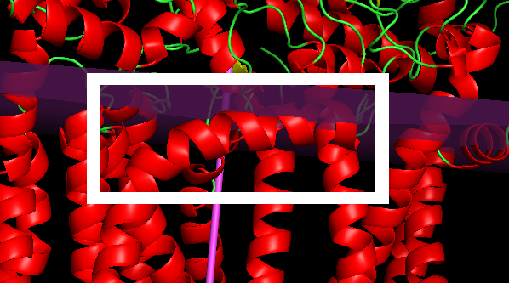
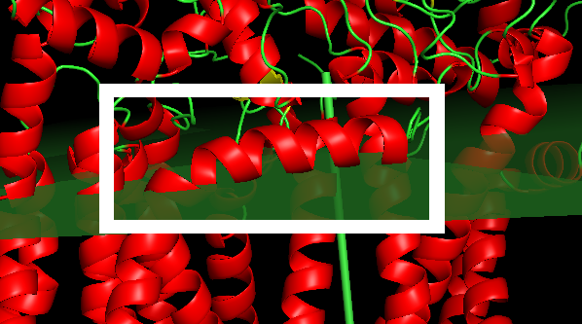
Optimisation Result
Before
After
1BE3, purple: before, green: after

Slide 19
Thank you for your attention!

Slide 20
Scores for non-TM proteins
Globulin -> 0.169
Hexokinase -> 0.162

